Slide 1

Data Structures
Week 10 - Trees
Juan Carlos Pineda
ITESM
juancarlos.pineda@itesm.mx

Slide 2
Introduction
A tree is a directed graph
Acyclic structure of linked nodes
- directed: Has one-way links between nodes.
-acyclic: No path wraps back around the same node twice

Slide 3
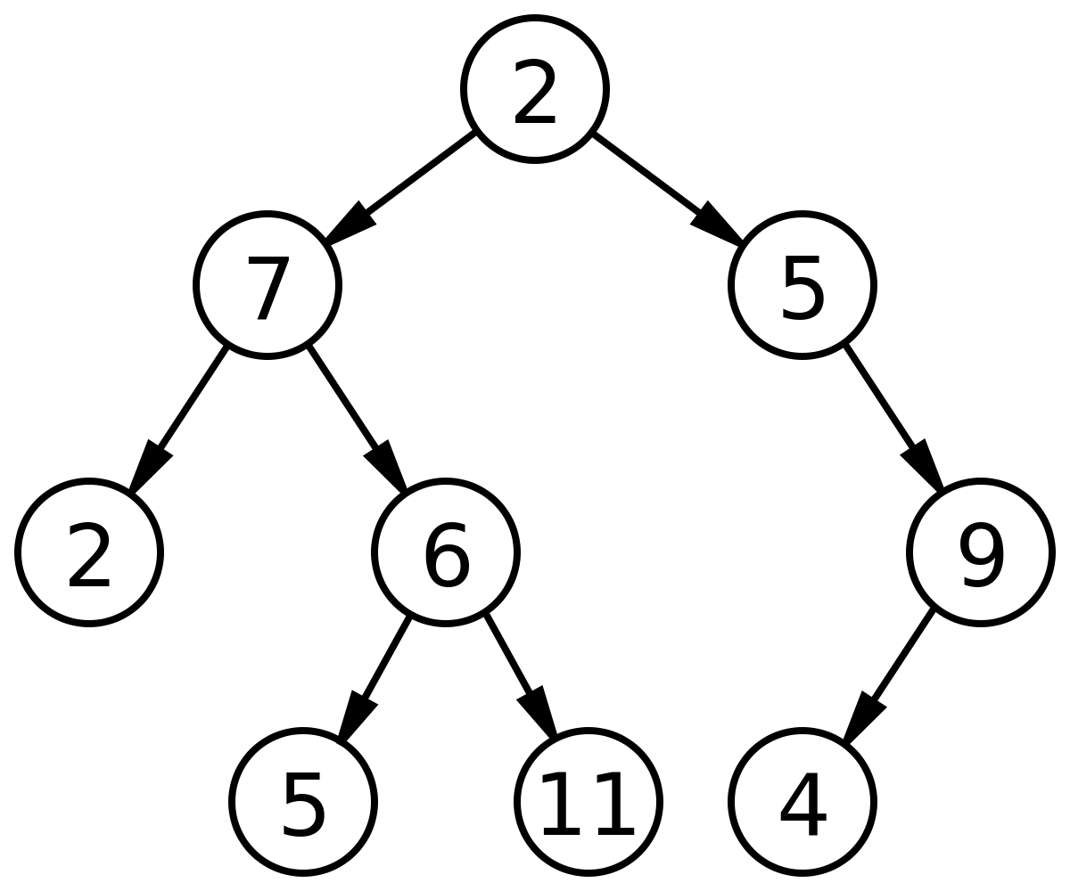
Trees
Binary tree: one where each node has at most two children
Recursive definition: A Tree is either:
-empty (nullptr)
-a root node that contains:
Data
A left subtree and
A right subtree
Notes:
5 minutes

Slide 4
Trees in computer science
Folders/files on a computer
Family genealogy; organizational charts
AI: decision trees
Compilers: parse tree
a= (b + c) * d;
Cell phone word auto-completion

Slide 5
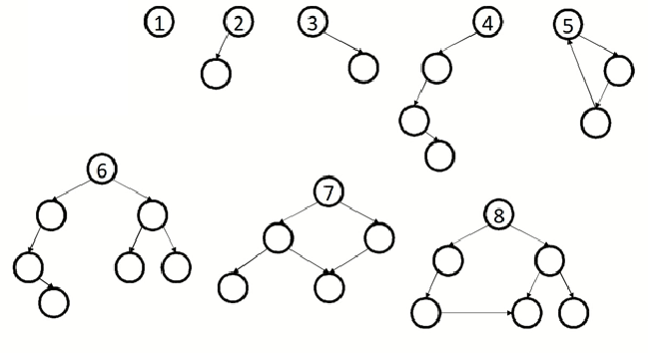
Trees question
How many of these diagrams are valid binary trees?

Slide 6
Terminology
Node: an object containing a data value and left/right children
Root: topmost node of a tree
Leaf: a node that has no children
branch> any internal node: neither the root nor a leaf
Parent: a node that refers to this one
Child: a node that this node refers to
Sibling> a node with a common parent
Subtree: the smaller tree of nodes on the left or right of the current node
height: length of the longest path from the root to any node
Level or depth: legth of the path from a root to a given node

Slide 7
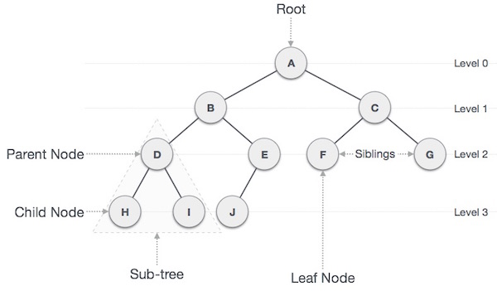
Terminology

Slide 8
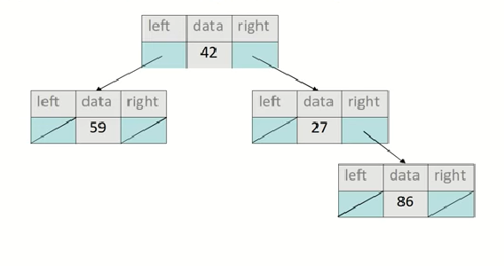
Tree implementation
A basic tree node object stores data and pointers to left/right

Slide 9
Tree Removal
55
29
87
42
60
91
36
73

Slide 10
Cases for removal
A leaf: replace with NULL
A node with a left child only: replace with left child
A node with a right child only: replace with right child
55
55
29
42
29
29
42
17
42
42
remove(42);
remove(17);
remove(55);

Slide 11
Cases for removal
[ADD ANIMATION]
4. A node with both children: replace with min from right (also max from left works)
55
60
29
87
29
87
17
42
60
91
17
42
91
remove(55);
Notes:
[ADD ANIMATION]

Slide 12
End of presentation

